Slide 1
Software Evolution
WK 6

Slide 2
Software maintenance
Modifying a program after it has been put into use.
The term is mostly used for changing custom software. Generic software products are said to evolve to create new versions.
Maintenance does not normally involve major changes to the system’s architecture.
Changes are implemented by modifying existing components and adding new components to the system.

Slide 3
Types of maintenance
Maintenance to repair software faults
Changing a system to correct deficiencies in the way meets its requirements.
Maintenance to adapt software to a different operating environment
Changing a system so that it operates in a different environment (computer, OS, etc.) from its initial implementation.
Maintenance to add to or modify the system’s functionality
Modifying the system to satisfy new requirements.

Slide 4
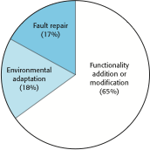
Figure 9.8 Maintenance effort distribution

Slide 5
Maintenance costs
Usually greater than development costs (2* to 100* depending on the application).
Affected by both technical and non-technical factors.
Increases as software is maintained. Maintenance corrupts the software structure so makes further maintenance more difficult.
Ageing software can have high support costs (e.g. old languages, compilers etc.).

Slide 6
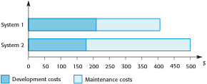
Figure 9.9 Development and maintenance costs

Slide 7
Maintenance cost factors
Team stability
Maintenance costs are reduced if the same staff are involved with them for some time.
Contractual responsibility
The developers of a system may have no contractual responsibility for maintenance so there is no incentive to design for future change.
Staff skills
Maintenance staff are often inexperienced and have limited domain knowledge.
Program age and structure
As programs age, their structure is degraded and they become harder to understand and change.

Slide 8
Maintenance prediction
Maintenance prediction is concerned with assessing which parts of the system may cause problems and have high maintenance costs
Change acceptance depends on the maintainability of the components affected by the change;
Implementing changes degrades the system and reduces its maintainability;
Maintenance costs depend on the number of changes and costs of change depend on maintainability.

Slide 9
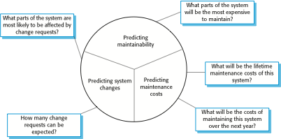
Maintenance prediction

Slide 10
Change prediction
Predicting the number of changes requires and understanding of the relationships between a system and its environment.
Tightly coupled systems require changes whenever the environment is changed.
Factors influencing this relationship are
Number and complexity of system interfaces;
Number of inherently volatile system requirements;
The business processes where the system is used.

Slide 11
Complexity metrics
Predictions of maintainability can be made by assessing the complexity of system components.
Studies have shown that most maintenance effort is spent on a relatively small number of system components.
Complexity depends on
Complexity of control structures;
Complexity of data structures;
Object, method (procedure) and module size.

Slide 12
Process metrics
Process metrics may be used to assess maintainability
Number of requests for corrective maintenance;
Average time required for impact analysis;
Average time taken to implement a change request;
Number of outstanding change requests.
If any or all of these is increasing, this may indicate a decline in maintainability.

Slide 13
System re-engineering
Re-structuring or re-writing part or all of a legacy system without changing its functionality.
Applicable where some but not all sub-systems of a larger system require frequent maintenance.
Re-engineering involves adding effort to make them easier to maintain. The system may be re-structured and re-documented.

Slide 14
Advantages of reengineering
Reduced risk
There is a high risk in new software development. There may be development problems, staffing problems and specification problems.
Reduced cost
The cost of re-engineering is often significantly less than the costs of developing new software.

Slide 15
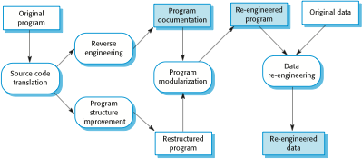
The reengineering process

Slide 16
Reengineering process activities
Source code translation
Convert code to a new language.
Reverse engineering
Analyse the program to understand it;
Program structure improvement
Restructure automatically for understandability;
Program modularisation
Reorganise the program structure;
Data reengineering
Clean-up and restructure system data.

Slide 17
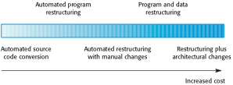
Reengineering approaches

Slide 18
Reengineering cost factors
The quality of the software to be reengineered.
The tool support available for reengineering.
The extent of the data conversion which is required.
The availability of expert staff for reengineering.
This can be a problem with old systems based on technology that is no longer widely used.

Slide 19
Preventative maintenance by refactoring
Refactoring is the process of making improvements to a program to slow down degradation through change.
You can think of refactoring as ‘preventative maintenance’ that reduces the problems of future change.
Refactoring involves modifying a program to improve its structure, reduce its complexity or make it easier to understand.
When you refactor a program, you should not add functionality but rather concentrate on program improvement.

Slide 20
Refactoring and reengineering
Re-engineering takes place after a system has been maintained for some time and maintenance costs are increasing. You use automated tools to process and re-engineer a legacy system to create a new system that is more maintainable.
Refactoring is a continuous process of improvement throughout the development and evolution process. It is intended to avoid the structure and code degradation that increases the costs and difficulties of maintaining a system.

Slide 21
‘Bad smells’ in program code
Duplicate code
The same or very similar code may be included at different places in a program. This can be removed and implemented as a single method or function that is called as required.
Long methods
If a method is too long, it should be redesigned as a number of shorter methods.
Switch (case) statements
These often involve duplication, where the switch depends on the type of a value. The switch statements may be scattered around a program. In object-oriented languages, you can often use polymorphism to achieve the same thing.

Slide 22
‘Bad smells’ in program code
Data clumping
Data clumps occur when the same group of data items (fields in classes, parameters in methods) re-occur in several places in a program. These can often be replaced with an object that encapsulates all of the data.
Speculative generality
This occurs when developers include generality in a program in case it is required in the future. This can often simply be removed.

Slide 23
Legacy system management
Organisations that rely on legacy systems must choose a strategy for evolving these systems
Scrap the system completely and modify business processes so that it is no longer required;
Continue maintaining the system;
Transform the system by re-engineering to improve its maintainability;
Replace the system with a new system.
The strategy chosen should depend on the system quality and its business value.

Slide 24
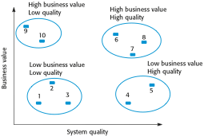
An example of a legacy system assessment

Slide 25
Legacy system categories
Low quality, low business value
These systems should be scrapped.
Low-quality, high-business value
These make an important business contribution but are expensive to maintain. Should be re-engineered or replaced if a suitable system is available.
High-quality, low-business value
Replace with COTS, scrap completely or maintain.
High-quality, high business value
Continue in operation using normal system maintenance.

Slide 26
Business value assessment
Assessment should take different viewpoints into account
System end-users;
Business customers;
Line managers;
IT managers;
Senior managers.
Interview different stakeholders and collate results.

Slide 27
Issues in business value assessment
The use of the system
If systems are only used occasionally or by a small number of people, they may have a low business value.
The business processes that are supported
A system may have a low business value if it forces the use of inefficient business processes.
System dependability
If a system is not dependable and the problems directly affect business customers, the system has a low business value.
The system outputs
If the business depends on system outputs, then the system has a high business value.

Slide 28
System quality assessment
Business process assessment
How well does the business process support the current goals of the business?
Environment assessment
How effective is the system’s environment and how expensive is it to maintain?
Application assessment
What is the quality of the application software system?

Slide 29
Business process assessment
Use a viewpoint-oriented approach and seek answers from system stakeholders
Is there a defined process model and is it followed?
Do different parts of the organisation use different processes for the same function?
How has the process been adapted?
What are the relationships with other business processes and are these necessary?
Is the process effectively supported by the legacy application software?
Example - a travel ordering system may have a low business value because of the widespread use of web-based ordering.

Slide 30
Factors used in environment assessment
Factor | Questions
Supplier stability | Is the supplier still in existence? Is the supplier financially stable and likely to continue in existence? If the supplier is no longer in business, does someone else maintain the systems?
Failure rate | Does the hardware have a high rate of reported failures? Does the support software crash and force system restarts?
Age | How old is the hardware and software? The older the hardware and support software, the more obsolete it will be. It may still function correctly but there could be significant economic and business benefits to moving to a more modern system.
Performance | Is the performance of the system adequate? Do performance problems have a significant effect on system users?

Slide 31
Factors used in environment assessment
Factor | Questions
Support requirements | What local support is required by the hardware and software? If there are high costs associated with this support, it may be worth considering system replacement.
Maintenance costs | What are the costs of hardware maintenance and support software licences? Older hardware may have higher maintenance costs than modern systems. Support software may have high annual licensing costs.
Interoperability | Are there problems interfacing the system to other systems? Can compilers, for example, be used with current versions of the operating system? Is hardware emulation required?

Slide 32
Factors used in application assessment
Factor | Questions
Understandability | How difficult is it to understand the source code of the current system? How complex are the control structures that are used? Do variables have meaningful names that reflect their function?
Documentation | What system documentation is available? Is the documentation complete, consistent, and current?
Data | Is there an explicit data model for the system? To what extent is data duplicated across files? Is the data used by the system up to date and consistent?
Performance | Is the performance of the application adequate? Do performance problems have a significant effect on system users?

Slide 33
Factors used in application assessment
Factor | Questions
Programming language | Are modern compilers available for the programming language used to develop the system? Is the programming language still used for new system development?
Configuration management | Are all versions of all parts of the system managed by a configuration management system? Is there an explicit description of the versions of components that are used in the current system?
Test data | Does test data for the system exist? Is there a record of regression tests carried out when new features have been added to the system?
Personnel skills | Are there people available who have the skills to maintain the application? Are there people available who have experience with the system?

Slide 34
System measurement
You may collect quantitative data to make an assessment of the quality of the application system
The number of system change requests;
The number of different user interfaces used by the system;
The volume of data used by the system.

Slide 35
Key points
There are 3 types of software maintenance, namely bug fixing, modifying software to work in a new environment, and implementing new or changed requirements.
Software re-engineering is concerned with re-structuring and re-documenting software to make it easier to understand and change.
Refactoring, making program changes that preserve functionality, is a form of preventative maintenance.
The business value of a legacy system and the quality of the application should be assessed to help decide if a system should be replaced, transformed or maintained.

